Slide 1
Chapter 7: Normalization

Slide 2
Overview of Normalization

Slide 3
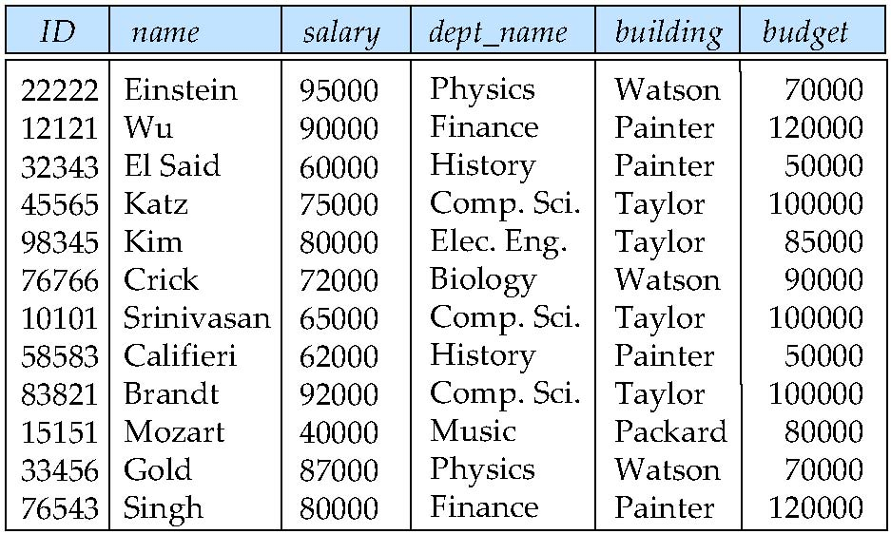
Features of Good Relational Designs
Suppose we combine instructor and department into in_dep, which represents the natural join on the relations instructor and department
There is repetition of information
Need to use null values (if we add a new department with no instructors)

Slide 4
“好”的关系数据库设计
关系数据库是由一组关系构成的
“好”的关系数据库设计要求我们找到一些“好”关系
包含“坏”关系的“坏”数据库设计具有某些问题

Slide 5
关系数据库中的问题
考虑以下数据库设计
  关系：worker (name, branch, manager)
  假设一个部门仅有一位经理。但反过来，一个经理可以是多个部门的经理。
worker
name | branch | manager
Jones | A | Frank
Smith | B | David
Curry | C | Frank
Larry | B | David
Julia | C | Frank

Slide 6
关系数据库中的问题
该数据库设计有如下问题
  冗余
    思考：有几个元组存储了David是部门B经理的信息？
    同部门的每一个员工都不必要地重复关于谁是部门经理的信息
worker
name | branch | manager
Jones | A | Frank
Smith | B | David
Curry | C | Frank
Larry | B | David
Julia | C | Frank

Slide 7
关系数据库中的问题
  更新异常
    思考：如果部门B的经理变成Debbie，需要更新几个元组？
    如果一个部门的经理变动，我们必须更新部门里的每个员工以反映谁是新经理，否则就会出现这样的错误：该部门有两个经理
worker
worker
name | branch | manager
Jones | A | Frank
Smith | B | David
Curry | C | Frank
Larry | B | David
Julia | C | Frank
name | branch | manager
Jones | A | Frank
Smith | B | Debbie
Curry | C | Frank
Larry | B | David
Julia | C | Frank
×

Slide 8
关系数据库中的问题
  插入异常
    思考：假设成立一个新部门D。经理是kevin，没有员工。我们能增加关于部门D的信息么？
    如果一个部门还没有员工，我们就无法添加这个部门的信息
worker
worker
name | branch | manager
Jones | A | Frank
Smith | B | David
Curry | C | Frank
Larry | B | David
Julia | C | Frank
name | branch | manager
Jones | A | Frank
Smith | B | David
Curry | C | Frank
Larry | B | David
Julia | C | Frank
null | D | Kevin
×

Slide 9
关系数据库中的问题
  删除异常
    思考：在删除了部门B的所有员工以后，我们还能找出谁是部门B的经理么？
    如果一个部门里的所有员工都被删除了，谁是部门经理的信息也会被删除
worker
worker
name | branch | manager
Jones | A | Frank
Smith | B | David
Curry | C | Frank
Larry | B | David
Julia | C | Frank
name | branch | manager
Jones | A | Frank
Curry | C | Frank
Julia | C | Frank
谁是部门B的经理?

Slide 10
什么导致了这些问题？
不良的数据依赖
  函数依赖(简记为FD)是一种数据依赖，它具有以下形式
  α → β (读作：α蕴涵β)
  意义：当任意两个元组在属性集α上相等时，则它们在属性集β上也相等。即同一个α（的值），必然对应同一个β（的值）

Slide 11
什么导致了这些问题？
  我们可以在worker关系中发现某些函数依赖，如下
        name → branch
        branch → manager
        name → manager
worker
name | branch | manager
Jones | A | Frank
Smith | B | David
Curry | C | Frank
Larry | B | David
Julia | C | Frank

Slide 12
什么导致了这些问题？
  worker关系的这些函数依赖中, branch → manager是不良的
    由于左边的branch不是关系的码（这里指超码），同一branch可能出现多次，造成同一组合: (branch，manager)的重复
worker
name | branch | manager
Jones | A | Frank
Smith | B | David
Curry | C | Frank
Larry | B | David
Julia | C | Frank

Slide 13
如何解决这些问题？
分解
  把一个“坏”关系分解为几个更小但是“好”的关系
  例如
  worker (name, branch, manager) →
  worker1 (name, branch),
  branch (branch, manager)

Slide 14
如何解决这些问题？
  在分解后消除了不良函数依赖，所以避免了同一组合的重复，解决了以上问题
worker
worker1
branch
name | branch | manager
Jones | A | Frank
Smith | B | David
Curry | C | Frank
Larry | B | David
Julia | C | Frank
name | branch
Jones | A
Smith | B
Curry | C
Larry | B
Julia | C
branch | manager
A | Frank
B | David
C | Frank

Slide 15
如何解决这些问题？
考虑另一种分解方案，如下所示
worker (name, branch, manager) →
worker2 (name, manager),
branch (branch, manager)
worker
worker2
Branch
name | branch | manager
Jones | A | Frank
Smith | B | David
Curry | C | Frank
Larry | B | David
Julia | C | Frank
name | manager
Jones | Frank
Smith | David
Curry | Frank
Larry | David
Julia | Frank
branch | manager
A | Frank
B | David
C | Frank

Slide 16
如何解决这些问题？
思考
  在分解后，你能找出Jones在哪个部门么？
不正确的分解可能带来新的问题：丢失某些信息
  例如，这里会丢失有关员工属于哪个部门的信息
worker
worker2
Branch
name | branch | manager
Jones | A | Frank
Smith | B | David
Curry | C | Frank
Larry | B | David
Julia | C | Frank
name | manager
Jones | Frank
Smith | David
Curry | Frank
Larry | David
Julia | Frank
branch | manager
A | Frank
B | David
C | Frank

Slide 17
思考与练习
观察以下关系，然后回答问题
  问题1：在这个关系上能找到哪些函数依赖？它们是“好”的还是“坏”的？
  问题2: 它是一个“好”关系么？如果不是，存在哪些问题？
选修
学号 | 课程号 | 课程名 | 分数
01 | A | 数据库 | 90
01 | B | C语言 | 85
02 | A | 数据库 | 70
02 | C | 算法分析 | 100
03 | B | C语言 | 80

Slide 18
数据库设计理论
如何获得“好”的数据库设计？
  ① 判定其中的一个关系R是否“好”的，即有没有“坏”数据依赖
  ② 如果R不是好的，则要正确地分解为几个较小的好关系
  ③ 重复以上两步，直到全部关系都变成“好”的为止

Slide 19
Functional
Dependencies

Slide 20
Functional Dependencies
There are usually a variety of constraints (rules) on the data in the real world.
For example, some of the constraints that are expected to hold in a university database are:
  Students and instructors are uniquely identified by their ID.
  Each student and instructor has only one name.
  Each instructor and student is (primarily) associated with only one department.
  Each department has only one value for its budget, and only one associated building.

Slide 21
Functional Dependencies (Cont.)
An instance of a relation that satisfies all such real-world constraints is called a legal instance of the relation;
A legal instance of a database is one where all the relation instances are legal instances
Constraints on the set of legal relations.
Require that the value for a certain set of attributes determines uniquely the value for another set of attributes.
A functional dependency is a generalization of the notion of a key.

Slide 22
Functional Dependencies Definition
Let R be a relation schema
α ⊆ R and β ⊆ R
The functional dependency
α → β
holds on R if and only if for any legal relations r(R), whenever any two tuples t₁ and t₂ of r agree on the attributes α, they also agree on the attributes β. That is,
t₁[α] = t₂ [α] ⇒ t₁[β ] = t₂ [β ]
Example: Consider r(A,B ) with the following instance of r.
On this instance, B → A hold; A → B does NOT hold,
4
1 5
3 7

Slide 23
补充：函数依赖
定义
  R: 一个关系
  U: 关系R中的所有属性
  α, β : R中一或多个属性的集合

Slide 24
函数依赖
  我们说关系R上存在以下函数依赖
  α → β (读作：α蕴涵β ，或β依赖α)
  的条件是当且仅当：任意两个元组如果在属性集α上相等，它们在属性集β上必然相等（ 同一个α对应同一个β）
t₁[α] = t₂ [α] ⇒ t₁[β ] = t₂ [β ]

Slide 25
函数依赖
例如
  考虑以下关系
  以上关系满足什么函数依赖？
student
name | college | city
Jones | SCNU | GZ
Smith | SCUT | GZ
Curry | TShingHua | BJ
Larry | PKU | BJ
Julia | PKU | BJ

Slide 26
Normal Forms

Slide 27
为什么使用范式？
“好”的关系数据库设计
  如何知道一个关系是否“好”，是否有“坏”的数据依赖
    判断属于哪一级别的范式
  ……
高级范式与低级范式相比，是“更好”的关系，因为“坏”数据依赖更少

Slide 28
范式
范式
  满足一定要求的所有关系的全集
范式级别(从低级到高级)
  第一范式 (1NF)
  第二范式 (2NF)
  第三范式 (3NF)
  BC范式 (BCNF)
  第四范式* (4NF)
  ……
范式越高级，代表的关系就越“好”，要满足的要求也就越高

Slide 29
范式
不同范式之间的联系
  4NF ⊂ BCNF ⊂ 3NF ⊂ 2NF ⊂ 1NF
  高级范式是低级范式的子集
    范式越高，满足的要求也就越高；满足高要求的关系肯定能够满足低要求，所以高级范式中的关系肯定也在低级范式中
1NF
2NF
3NF
BCNF
4NF

Slide 30
第一范式
要求
  关系的每个属性都是原子的
原子属性
  属性值不可再分
  例如. age, sex
非原子属性
  属性值可以再分，包括——
  复合属性，例如parents
  多值属性，例如phone-numbers

Slide 31
第一范式
例子
  下面关系中，哪些在1NF中，哪些不在？
Student
Student
学号 | 姓名 | 课程号
S1 | John | {C1，C2，C3}
S2 | Smith | {C3，C5}
学号 | 姓名 | 父母
S1 | John | (Tom, Angie)
S2 | Smith | (Mike, Sophie)
Student
学号 | 姓名 | 性别 | 年龄
S1 | John | Male | 22
S2 | Smith | Male | 23

Slide 32
一些术语和解释
例子关系
  R(ABCDE)。候选码只有一个ABC，所以也是主码。
码属性（主属性, prime attribute）
  一个属性，出现在某个候选码（candidate key）中
  例如：A, B, C
非码属性（非主属性, non-prime attribute ）
  一个属性，不出现在任何一个候选码中
  例如：D, E
（候选码）码的一部分
  就是候选码的真子集。
  例如，AB, BC, AC, A, B, C等等

Slide 33
一些术语和解释
超码
  具有唯一性的属性集。
  超码里面如果有多余的属性，那么去除后剩下的就是候选码。所以直观上看，超码含有或等于候选码。
  例如：ABC, ABCD, ABCE, ABCDE都是超码
非码
  非超码，也就是超码以外，不具有唯一性的属性集。
  直观上看，非码不含有候选码
  例如：AC, AD, CD, BD等都是非码

Slide 34
第二范式
要求
  关系在1NF中
  每个非码属性都完全函数依赖于候选码
    判断是否属于2NF：检查每个非码属性，是否可能依赖于候选码的一部分？有，不属于，否则属于。

Slide 35
第二范式
例子
  以下关系在1NF中？在2NF中？为什么？
  它们有我们以前讨论过的四个问题吗？
SC
SC
学号 | 姓名 | 课程号 | 课程名
S1 | John | C1 | database
S2 | Smith | C1 | database
S1 | John | C2 | algorithm
S2 | Smith | C2 | algorithm
学号 | 课程号 | 成绩
S1 | C1 | 77
S2 | C1 | 80
S1 | C2 | 90
S2 | C2 | 82

Slide 36
第三范式
要求
  关系在1NF中
  每个非码属性都非传递依赖于候选码
    判断是否属于3NF：检查每个非码属性, 是否只依赖于超码（包含候选码）。如果有依赖于非超码，不属于，否则属于。
    注意, 因为任何属性集都函数依赖于候选码(K→U)，所以非码属性A依赖于某个非码B的同时，也就传递依赖了候选码K (K→B→A)

Slide 37
第三范式
例子
  以下关系在3NF中？在2NF中？
  它们有我们以前讨论过的四个问题吗？
Student
Student
学号 | 姓名 | 班号 | 班名
S1 | 小王 | C1 | 会计班
S2 | 小张 | C1 | 会计班
S3 | 小李 | C2 | 电算班
S4 | 小孙 | C2 | 电算班
学号 | 姓名 | 班号
S1 | 小王 | C1
S2 | 小张 | C1
S3 | 小李 | C2
S4 | 小孙 | C2

Slide 38
Third Normal Form
A relation schema R is in third normal form (3NF) if for all:
α → β in F⁺
at least one of the following holds:
  α → β is trivial (i.e., β ∈ α)
  α is a superkey for R
  Each attribute A in β – α is contained in a candidate key for R.
  (NOTE: each attribute may be in a different candidate key)
If a relation is in BCNF it is in 3NF (since in BCNF one of the first two conditions above must hold).
Third condition is a minimal relaxation of BCNF to ensure dependency preservation (will see why later).
Notes:
定义： 非主属性既不传递依赖于码，也不部分依赖于码。

Slide 39
3NF Example
Consider a schema:
dept_advisor(s_ID, i_ID, dept_name)
With function dependencies:
i_ID → dept_name
s_ID, dept_name → i_ID
Two candidate keys = {s_ID, dept_name}, {s_ID, i_ID }
We have seen before that dept_advisor is not in BCNF
R, however, is in 3NF
  s_ID, dept_name is a superkey
  i_ID → dept_name and i_ID is NOT a superkey, but:
    { dept_name} – {i_ID } = {dept_name } and
    dept_name is contained in a candidate key
不用管主属性？

Slide 40

Redundancy in 3NF
Consider the schema R below, which is in 3NF
What is wrong with the table?
  R = (J, K, L )
  F = {JK → L, L → K }
  And an instance table:
  Repetition of information
  Need to use null values (e.g., to represent the relationship l₂, k₂
  where there is no corresponding value for J)

Slide 41
Boyce-Codd Normal Form
A relation schema R is in BCNF with respect to a set F of functional dependencies if for all functional dependencies in F⁺ of the form
α → β
where α ⊆ R and β ⊆ R, at least one of the following holds:
  α → β is trivial (i.e., β ⊆ α)
  α is a superkey for R
Notes:
所有非主属性对每一个码都是完全函数依赖；
没有任何属性完全函数依赖于非码的任何一组属性。
所有主属性对每一个不包含它的码也是完全函数依赖

Slide 42
Boyce-Codd Normal Form (Cont.)
Example schema that is not in BCNF:
in_dep (ID, name, salary, dept_name, building, budget )
because :
  dept_name→ building, budget
    holds on in_dep
    but dept_name is not a superkey
When decompose in_dept into instructor and department
  instructor is in BCNF
  department is in BCNF

Slide 43
例子：范式
例子
  考虑以下关系
  R(S, T, C)
    S: 学生; T: 教师; C: 课程
R
S | T | C
Smith | Jones | Java
Curry | Jones | Java
Smith | Frank | C++
Curry | Frank | C++
Larry | David | C++

Slide 44
范式
    假设一个教师只教一门课程，但是一门课程有多个教师。也就是T→C
    假设给定一个学生和一门课程，只有一个老师给他上这门课程。也就是SC→T
  所以函数依赖集为: F={ T→C, SC→T }
R
S | T | C
Smith | Jones | Java
Curry | Jones | Java
Smith | Frank | C++
Curry | Frank | C++
Larry | David | C++

Slide 45
范式
    R(S, T, C), F={ T→C, SC→T }
  问题1: R的候选码是什么？
    候选码: ST, SC
    证明: (ST)⁺=(STC), (SC)⁺=(STC),所以ST, SC是超码. 而(S)⁺=(S), (T)⁺=(TC), (C)⁺=(C), 所以ST, SC的真子集都不是超码
R
S | T | C
Smith | Jones | Java
Curry | Jones | Java
Smith | Frank | C++
Curry | Frank | C++
Larry | David | C++

Slide 46
范式
    R(S, T, C), F={ T→C, SC→T },
    候选码: ST, SC
  问题2: R在3NF中么？在BCNF中么？
    R在3NF中，因为R中没有非码属性
    R不在BCNF中，因为T→C是非平凡的，且左边T不是超码
R
S | T | C
Smith | Jones | Java
Curry | Jones | Java
Smith | Frank | C++
Curry | Frank | C++
Larry | David | C++

Slide 47
BC范式
    R(S, T, C), F={ T→C, SC→T },
    候选码: ST, SC
  问题3: 它们有我们以前讨论过的四个问题吗？
    是的，因为组合(T, C)的值重复
R
S | T | C
Smith | Jones | Java
Curry | Jones | Java
Smith | Frank | C++
Curry | Frank | C++
Larry | David | C++

Slide 48
总结
检查每个函数依赖： α → β | 结论
α 非码 | 非BCNF
α 非码， β 有非码属性 | 非3NF
α 是候选码的一部分，β有非码属性 | 非2NF

Slide 49
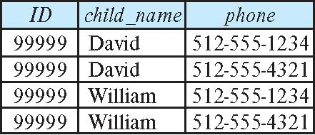
How good is BCNF?
There are database schemas in BCNF that do not seem to be sufficiently normalized
Consider a relation
inst_info (ID, child_name, phone)
  where an instructor may have more than one phone and can have multiple children
  Instance of inst_info

Slide 50
How good is BCNF? (Cont.)
There are no non-trivial functional dependencies and therefore the relation is in BCNF
Insertion anomalies – i.e., if we add a phone 981-992-3443 to 99999, we need to add two tuples
(99999, David, 981-992-3443)
(99999, William, 981-992-3443)

Slide 51
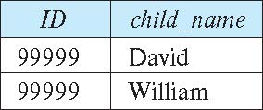
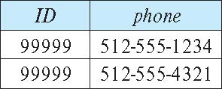
Higher Normal Forms
It is better to decompose inst_info into:
  inst_child:
  inst_phone:
This suggests the need for higher normal forms, such as Fourth Normal Form (4NF), which we shall see later

Slide 52
Decomposition

Slide 53
Decomposition
The only way to avoid the repetition-of-information problem in the inst_dep schema is to decompose it into two schemas – instructor and department schemas.
Not all decompositions are good. Suppose we decompose
employee(ID, name, street, city, salary)
into
employee1 (ID, name)
employee2 (name, street, city, salary)
The problem arises when we have two employees with the same name
The next slide shows how we lose information -- we cannot reconstruct the original employee relation -- and so, this is a lossy decomposition.

Slide 54
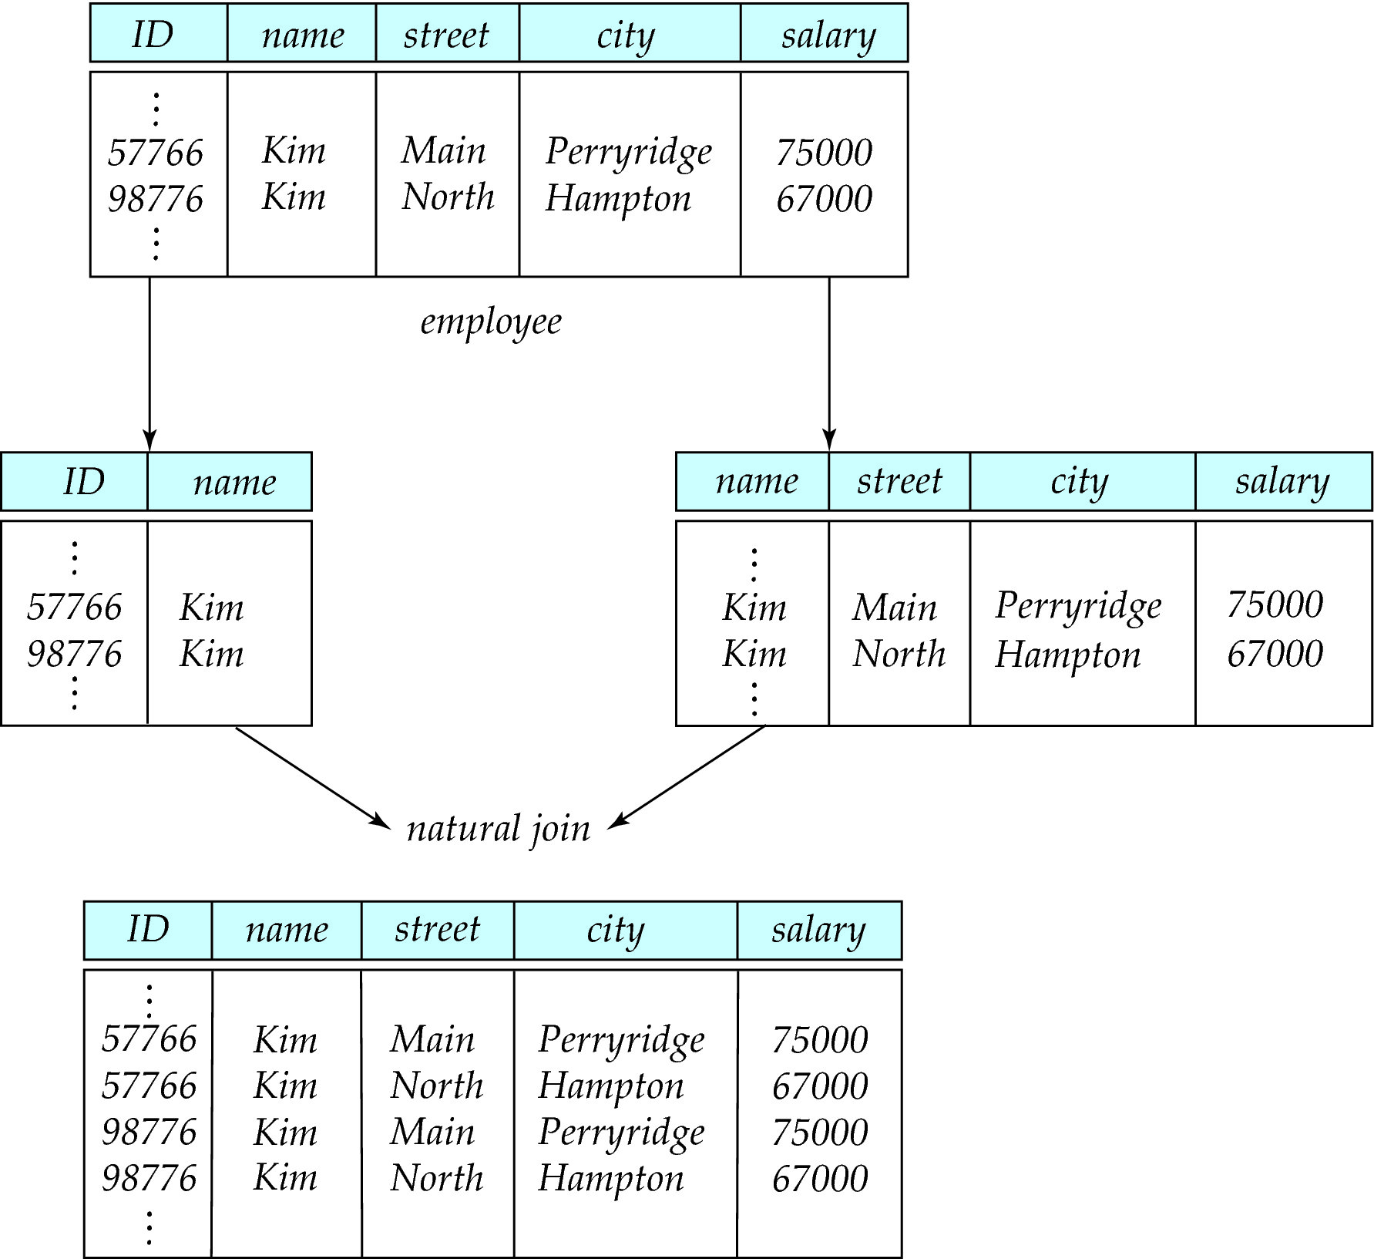
A Lossy Decomposition

Slide 55
Lossless Decomposition
Let R be a relation schema and let R₁ and R₂ form a decomposition of R . That is R = R₁ U R₂
We say that the decomposition is a lossless decomposition if there is no loss of information by replacing R with the two relation schemas R₁ U R₂
Formally,
∏ _{R1} (r) ∏ _{R2} (r) = r
And, conversely a decomposition is lossy if
  r ⊂ ∏ _{R1} (r) ∏ _{R2} (r) = r

Slide 56
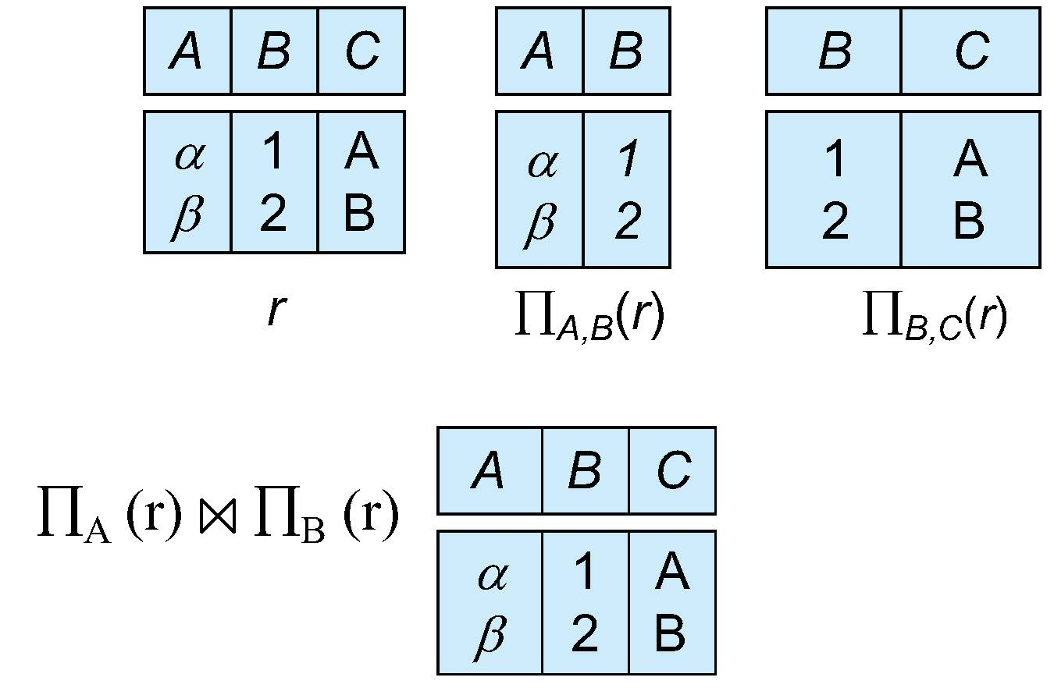
Example of Lossless Decomposition
Decomposition of R = (A, B, C)
R₁ = (A, B) R₂ = (B, C)

Slide 57
Normalization Theory
Decide whether a particular relation R is in “good” form.
In the case that a relation R is not in “good” form, decompose it into set of relations {R₁, R₂, ..., R_{n}} such that
  Each relation is in good form
  The decomposition is a lossless decomposition
Our theory is based on:
  Functional dependencies
  Multivalued dependencies

Slide 58
Closure of a Set of Functional Dependencies
Given a set F set of functional dependencies, there are certain other functional dependencies that are logically implied by F.
  If A → B and B → C, then we can infer that A → C
  etc.
The set of all functional dependencies logically implied by F is the closure of F.
We denote the closure of F by F⁺.

Slide 59
Keys and Functional Dependencies
K is a superkey for relation schema R if and only if K → R
K is a candidate key for R if and only if
  K → R, and
  for no α ⊂ K, α → R
Functional dependencies allow us to express constraints that cannot be expressed using superkeys. Consider the schema:
in_dep (ID, name, salary, dept_name, building, budget ).
We expect these functional dependencies to hold:
dept_name→ building
ID → building
but would not expect the following to hold:
dept_name → salary

Slide 60
Use of Functional Dependencies
We use functional dependencies to:
  To test relations to see if they are legal under a given set of functional dependencies.
    If a relation r is legal under a set F of functional dependencies, we say that r satisfies F.
  To specify constraints on the set of legal relations
    We say that F holds on R if all legal relations on R satisfy the set of functional dependencies F.
Note: A specific instance of a relation schema may satisfy a functional dependency even if the functional dependency does not hold on all legal instances.
  For example, a specific instance of instructor may, by chance, satisfy
  name → ID.

Slide 61
Trivial Functional Dependencies
A functional dependency is trivial if it is satisfied by all instances of a relation
Example:
  ID, name → ID
  name → name
In general, α → β is trivial if β ⊆ α
函数依赖α → β，当β ⊆ α 时是平凡的；否则是非平凡的
平凡的函数依赖总是成立的，为什么？
  换句话说，平凡的函数依赖是没有意义的，我们一般所讨论的函数依赖都应该排除这种情况。

Slide 62
如何让关系达到更高的范式?
分解
  把一个属于低级范式的“坏”关系，分解为几个属于高级范式的 “好”关系
  但是某些情况下分解会带来新的问题，比如信息丢失，这样的分解是不正确的。
要点
  什么样的分解方案才是正确的（不丢失信息的）?
  Dependency Preservation
  Lossless Decomposition
  (怎么做到？）

Slide 63
如何让关系达到更高的范式?
分解
  把一个属于低级范式的“坏”关系，分解为几个属于高级范式的 “好”关系
  但是某些情况下分解会带来新的问题，比如信息丢失，这样的分解是不正确的。
两个要点
  1. 什么样的分解方案才是正确的（不丢失信息的）? —— Lossless-join decomposition and dependency preserving
  2. 怎么找到正确的分解方案? —— 规范化

Slide 64
Decomposing a Schema into BCNF
Let R be a schema R that is not in BCNF. Let α →β be the FD that causes a violation of BCNF.
We decompose R into:
  (α U β )
  ( R - ( β - α ) )
In our example of in_dep,
  α = dept_name
  β = building, budget
  and in_dep is replaced by
  (α U β ) = ( dept_name, building, budget )
  ( R - ( β - α ) ) = ( ID, name, dept_name, salary )

Slide 65

Example
R = (A, B, C)
F = {A → B, B → C)
R₁ = (A, B), R₂ = (B, C)
  Lossless-join decomposition:
  R₁ ∩ R₂ = {B} and B → BC
  Dependency preserving
R₁ = (A, B), R₂ = (A, C)
  Lossless-join decomposition:
  R₁ ∩ R₂ = {A} and A → AB
  Not dependency preserving
  (cannot check B → C without computing R₁ R₂)

Slide 66
BCNF and Dependency Preservation
It is not always possible to achieve both BCNF and dependency preservation
Consider a schema:
dept_advisor(s_ID, i_ID, department_name)
With function dependencies:
i_ID → dept_name
s_ID, dept_name → i_ID
dept_advisor is not in BCNF
  i_ID is not a superkey.
Any decomposition of dept_advisor will not include all the attributes in
s_ID, dept_name → i_ID
Thus, the composition is NOT be dependency preserving

Slide 67
Comparison of BCNF and 3NF
Advantages to 3NF over BCNF. It is always possible to obtain a 3NF design without sacrificing loss or dependency preservation.
Disadvantages to 3NF.
  We may have to use null values to represent some of the possible meaningful relationships among data items.
  There is the problem of repetition of information.

Slide 68
Goals of Normalization
Let R be a relation scheme with a set F of functional dependencies.
Decide whether a relation scheme R is in “good” form.
In the case that a relation scheme R is not in “good” form, need to decompose it into a set of relation scheme {R₁, R₂, ..., R_{n}} such that:
  Each relation scheme is in good form
  The decomposition is a lossless decomposition
  Preferably, the decomposition should be dependency preserving.

Slide 69
Functional-Dependency Theory

Slide 70
Functional-Dependency Theory Roadmap
We now consider the formal theory that tells us which functional dependencies are implied logically by a given set of functional dependencies.
We then develop algorithms to generate lossless decompositions into BCNF and 3NF
We then develop algorithms to test if a decomposition is dependency-preserving

Slide 71
Closure of a Set of Functional Dependencies
Given a set F set of functional dependencies, there are certain other functional dependencies that are logically implied by F.
  If A → B and B → C, then we can infer that A → C
  etc.
The set of all functional dependencies logically implied by F is the closure of F.
We denote the closure of F by F⁺.
Why？
Notes:
闭包

Slide 72
Closure of a Set of Functional Dependencies
We can compute F⁺, the closure of F, by repeatedly applying Armstrong’s Axioms:
  Reflexive rule: if β ⊆ α, then α → β
  Augmentation rule: if α → β, then γ α → γ β
  Transitivity rule: if α → β, and β → γ, then α → γ
These rules are
  Sound -- generate only functional dependencies that actually hold, and
  Complete -- generate all functional dependencies that hold.

Slide 73
Example of F⁺
R = (A, B, C, G, H, I)
F = { A → B
A → C
CG → H
CG → I
B → H}
Some members of F⁺
  A → H
    by transitivity from A → B and B → H
  AG → I
    by augmenting A → C with G, to get AG → CG
    and then transitivity with CG → I
  CG → HI
    by augmenting CG → I to infer CG → CGI,
    and augmenting of CG → H to infer CGI → HI,
    and then transitivity

Slide 74
Closure of Functional Dependencies (Cont.)
Additional rules:
  Union rule: If α → β holds and α → γ holds, then α → β γ holds.
  Decomposition rule: If α → β γ holds, then α → β holds and α → γ holds.
  Pseudotransitivity rule:If α → β holds and γ β → δ holds, then α γ → δ holds.
The above rules can be inferred from Armstrong’s axioms.

Slide 75
Procedure for Computing F⁺
To compute the closure of a set of functional dependencies F:
F ⁺ = F
repeat
for each functional dependency f in F⁺
apply reflexivity and augmentation rules on f
add the resulting functional dependencies to F ⁺
for each pair of functional dependencies f₁and f₂ in F ⁺
if f₁ and f₂ can be combined using transitivity
then add the resulting functional dependency to F ⁺
until F ⁺ does not change any further
NOTE: We shall see an alternative procedure for this task later

Slide 76
Closure of Attribute Sets
Given a set of attributes α, define the closure of α under F (denoted by α⁺) as the set of attributes that are functionally determined by α under F
Algorithm to compute α⁺, the closure of α under F
result := α;
while (changes to result) do
for each β → γ in F do
begin
if β ⊆ result then result := result ∪ γ
end
Notes:
属性集的闭包

Slide 77
Example of Attribute Set Closure
R = (A, B, C, G, H, I)
F = {A → B
A → C
CG → H
CG → I
B → H}
(AG)⁺
  1. result = AG
  2. result = ABCG (A → C and A → B)
  3. result = ABCGH (CG → H and CG ⊆ AGBC)
  4. result = ABCGHI (CG → I and CG ⊆ AGBCH)
Is AG a candidate key?
  Is AG a super key?
    Does AG → R? == Is R ⊇ (AG)⁺
  Is any subset of AG a superkey?
    Does A → R? == Is R ⊇ (A)⁺
    Does G → R? == Is R ⊇ (G)⁺
    In general: check for each subset of size n-1

Slide 78
Uses of Attribute Closure
There are several uses of the attribute closure algorithm:
Testing for superkey:
  To test if α is a superkey, we compute α^{+,} and check if α⁺ contains all attributes of R.
Testing functional dependencies
  To check if a functional dependency α → β holds (or, in other words, is in F⁺), just check if β ⊆ α⁺.
  That is, we compute α⁺ by using attribute closure, and then check if it contains β.
  Is a simple and cheap test, and very useful
Computing closure of F
  For each γ ⊆ R, we find the closure γ⁺, and for each S ⊆ γ⁺, we output a functional dependency γ → S.

Slide 79
练习
R (C, T, H, R, S)
F = {C→T, HR→C, HT→R, HS→R}
问题1：求(HR) ⁺？
问题2：HS是候选码么？
问题3：CH → S成立么？

Slide 80
Canonical Cover
Suppose that we have a set of functional dependencies F on a relation schema. Whenever a user performs an update on the relation, the database system must ensure that the update does not violate any functional dependencies; that is, all the functional dependencies in F are satisfied in the new database state.
If an update violates any functional dependencies in the set F, the system must roll back the update.
We can reduce the effort spent in checking for violations by testing a simplified set of functional dependencies that has the same closure as the given set.
This simplified set is termed the canonical cover
To define canonical cover we must first define extraneous attributes.
  An attribute of a functional dependency in F is extraneous if we can remove it without changing F ⁺

Slide 81
Extraneous Attributes
Removing an attribute from the left side of a functional dependency could make it a stronger constraint.
  For example, if we have AB → C and remove B, we get the possibly stronger result A → C. It may be stronger because A → C logically implies AB → C, but AB → C does not, on its own, logically imply A → C
But, depending on what our set F of functional dependencies happens to be, we may be able to remove B from AB → C safely.
  For example, suppose that
  F = {AB → C, A → D, D → C}
  Then we can show that F logically implies A → C, making extraneous in AB → C.

Slide 82
Extraneous Attributes (Cont.)
Removing an attribute from the right side of a functional dependency could make it a weaker constraint.
  For example, if we have AB → CD and remove C, we get the possibly weaker result AB → D. It may be weaker because using just AB → D, we can no longer infer AB → C.
But, depending on what our set F of functional dependencies happens to be, we may be able to remove C from AB → CD safely.
  For example, suppose that
  F = { AB → CD, A → C.
  Then we can show that even after replacing AB → CD by AB → D, we can still infer $AB → C and thus AB → CD.

Slide 83
Extraneous Attributes
An attribute of a functional dependency in F is extraneous if we can remove it without changing F ⁺
Consider a set F of functional dependencies and the functional dependency α → β in F.
  Remove from the left side: Attribute A is extraneous in α if
    A ∈ α and
    F logically implies (F – {α → β}) ∪ {(α – A) → β}.
  Remove from the right side: Attribute A is extraneous in β if
    A ∈ β and
    The set of functional dependencies
    (F – {α → β}) ∪ {α →(β – A)} logically implies F.
Note: implication in the opposite direction is trivial in each of the cases above, since a “stronger” functional dependency always implies a weaker one

Slide 84
Testing if an Attribute is Extraneous
Let R be a relation schema and let F be a set of functional dependencies that hold on R . Consider an attribute in the functional dependency α → β.
To test if attribute A ∈ β is extraneous in β
  Consider the set:
  F' = (F – {α → β}) ∪ {α →(β – A)},
  check that α⁺ contains A; if it does, A is extraneous in β
To test if attribute A ∈ α is extraneous in α
  Let γ = α – {A}. Check if γ → β can be inferred from F.
    Compute γ⁺ using the dependencies in F
    If γ⁺ includes all attributes in β then , A is extraneous in α

Slide 85
Examples of Extraneous Attributes
Let F = {AB → CD, A → E, E → C }
To check if C is extraneous in AB → CD, we:
  Compute the attribute closure of AB under F' = {AB → D, A → E, E → C}
  The closure is ABCDE, which includes CD
  This implies that C is extraneous

Slide 86
Canonical Cover
A canonical cover for F is a set of dependencies F_{c} such that
F logically implies all dependencies in F_{c} , and
F_{c} logically implies all dependencies in F, and
No functional dependency in F_{c} contains an extraneous attribute, and
Each left side of functional dependency in F_{c} is unique. That is, there are no two dependencies in F_{c}
  α₁ → β₁ and α₂ → β₂ such that
  α₁ = α₂

Slide 87
Canonical Cover
To compute a canonical cover for F:
repeat
Use the union rule to replace any dependencies in F of the form
α₁ → β₁ and α₁ → β₂ with α₁ → β₁ β₂
Find a functional dependency α → β in F_{c} with an extraneous
attribute either in α or in β
/* Note: test for extraneous attributes done using F_{c,} not F*/
If an extraneous attribute is found, delete it from α → β
until (F_{c} not change）
Note: Union rule may become applicable after some extraneous attributes have been deleted, so it has to be re-applied

Slide 88
Example: Computing a Canonical Cover
R = (A, B, C)
F = {A → BC
B → C
A → B
AB → C}
Combine A → BC and A → B into A → BC
  Set is now {A → BC, B → C, AB → C}
A is extraneous in AB → C
  Check if the result of deleting A from AB → C is implied by the other dependencies
    Yes: in fact, B → C is already present!
  Set is now {A → BC, B → C}
C is extraneous in A → BC
  Check if A → C is logically implied by A → B and the other dependencies
    Yes: using transitivity on A → B and B → C.
      Can use attribute closure of A in more complex cases
The canonical cover is: A → B
B → C

Slide 89
Algorithm for Decomposition Using
Functional Dependencies

Slide 90
如何让关系达到更高的范式?
分解
  把一个属于低级范式的“坏”关系，分解为几个属于高级范式的 “好”关系
  但是某些情况下分解会带来新的问题，比如信息丢失，这样的分解是不正确的。
两个要点
  什么样的分解方案才是正确的（不丢失信息的）? —— 无损连接分解：
  Dependency Preservation
  Lossless Decomposition

Slide 91
Dependency Preservation
Let F_{i} be the set of dependencies F ⁺ that include only attributes in R_{i}.
  A decomposition is dependency preserving, if
  (F₁ ∪ F₂ ∪ … ∪ F_{n} )⁺ = F ⁺
Using the above definition, testing for dependency preservation take exponential time.
Not that if a decomposition is NOT dependency preserving then checking updates for violation of functional dependencies may require computing joins, which is expensive.

Slide 92
Dependency Preservation (Cont.)
Let F be the set of dependencies on schema R and let R₁, R₂ , .., R_{n} be a decomposition of R.
The restriction of F to R_{i} is the set F_{i} of all functional dependencies in F ⁺ that include only attributes of R_{i} .
Since all functional dependencies in a restriction involve attributes of only one relation schema, it is possible to test such a dependency for satisfaction by checking only one relation.
Note that the definition of restriction uses all dependencies in in F ⁺, not just those in F.
The set of restrictions F₁, F₂ , .. , F_{n} is the set of functional dependencies that can be checked efficiently.

Slide 93
Testing for Dependency Preservation
To check if a dependency α → β is preserved in a decomposition of R into R₁, R₂, …, R_{n} , we apply the following test (with attribute closure done with respect to F)
  result = α
  repeat
  for each R_{i} in the decomposition
  t = (result ∩ R_{i})⁺ ∩ R_{i}
  result = result ∪ t
  until (result does not change)
  If result contains all attributes in β, then the functional dependency α → β is preserved.
We apply the test on all dependencies in F to check if a decomposition is dependency preserving
This procedure takes polynomial time, instead of the exponential time required to compute F⁺ and (F₁ ∪ F₂ ∪ … ∪ F_{n})⁺

Slide 94
Example
R = (A, B, C )
F = {A → B
B → C}
Key = {A}
R is not in BCNF
Decomposition R₁ = (A, B), R₂ = (B, C)
  R₁ and R₂ in BCNF
  Lossless-join decomposition
  Dependency preserving

Slide 95
Lossless Decomposition
We can use functional dependencies to show when certain decomposition are lossless.
For the case of R = (R₁, R₂), we require that for all possible relations r on schema R
r = ∏_{R1} (r ) ∏_{R2} (r )
A decomposition of R into R₁ and R₂ is lossless decomposition if at least one of the following dependencies is in F⁺:
  R₁ ∩ R₂ → R₁
  R₁ ∩ R₂ → R₂
The above functional dependencies are a sufficient condition for lossless join decomposition; the dependencies are a necessary condition only if all constraints are functional dependencies

Slide 96
Example
R = (A, B, C)
F = {A → B, B → C)
R₁ = (A, B), R₂ = (B, C)
  Lossless decomposition:
  R₁ ∩ R₂ = {B} and B → BC
R₁ = (A, B), R₂ = (A, C)
  Lossless decomposition:
  R₁ ∩ R₂ = {A} and A → AB
Note:
  B → BC
  is a shorthand notation for
  B → {B, C}

Slide 97
Example
R(C, T, H, R, S)
F = { C→T, HR→C, HT→R, HS→R }
问题1: R → R1(C, H, S), R2(C, T, H, R). 这一分解是无损的么?

Slide 98
Dependency Preservation
Testing functional dependency constraints each time the database is updated can be costly
It is useful to design the database in a way that constraints can be tested efficiently.
If testing a functional dependency can be done by considering just one relation, then the cost of testing this constraint is low
When decomposing a relation it is possible that it is no longer possible to do the testing without having to perform a Cartesian Produced.
A decomposition that makes it computationally hard to enforce functional dependency is said to be NOT dependency preserving.

Slide 99
Dependency Preservation Example
Consider a schema:
dept_advisor(s_ID, i_ID, department_name)
With function dependencies:
i_ID → dept_name
s_ID, dept_name → i_ID
In the above design we are forced to repeat the department name once for each time an instructor participates in a dept_advisor relationship.
To fix this, we need to decompose dept_advisor
Any decomposition will not include all the attributes in
s_ID, dept_name → i_ID
Thus, the composition NOT be dependency preserving

Slide 100
Testing for BCNF
To check if a non-trivial dependency α →β causes a violation of BCNF
  1. compute α⁺ (the attribute closure of α), and
  2. verify that it includes all attributes of R, that is, it is a superkey of R.
Simplified test: To check if a relation schema R is in BCNF, it suffices to check only the dependencies in the given set F for violation of BCNF, rather than checking all dependencies in F⁺.
  If none of the dependencies in F causes a violation of BCNF, then none of the dependencies in F⁺ will cause a violation of BCNF either.
However, simplified test using only F is incorrect when testing a relation in a decomposition of R
  Consider R = (A, B, C, D, E), with F = { A → B, BC → D}
    Decompose R into R₁ = (A,B) and R₂ = (A,C,D, E)
    Neither of the dependencies in F contain only attributes from
    (A,C,D,E) so we might be mislead into thinking R₂ satisfies BCNF.
    In fact, dependency AC → D in F⁺ shows R₂ is not in BCNF.

Slide 101
Testing Decomposition for BCNF
To check if a relation R_{i} in a decomposition of R is in BCNF
Either test R_{i} for BCNF with respect to the restriction of F⁺ to R_{i} (that is, all FDs in F⁺ that contain only attributes from R_{i})
Or use the original set of dependencies F that hold on R, but with the following test:
    for every set of attributes α ⊆ R_{i}, check that α⁺ (the attribute closure of α) either includes no attribute of R_{i}- α, or includes all attributes of R_{i}.
  If the condition is violated by some α → β in F⁺, the dependency
  α → (α⁺ - α) ∩ R_{i}
  can be shown to hold on R_{i}, and R_{i} violates BCNF.
  We use above dependency to decompose R_{i}

Slide 102
BCNF Decomposition Algorithm
result := {R };
done := false;
compute F ⁺;
while (not done) do
if (there is a schema R_{i} in result that is not in BCNF)
then begin
let α → β be a nontrivial functional dependency that
holds on R_{i} such that α → R_{i} is not in F ⁺,
and α ∩ β = ∅;
result :=｛ (result – R_{i} ) ∪ (R_{i} – β) ｝∪ ｛(α, β )｝;
end
else done := true;
Note: each R_{i} is in BCNF, and decomposition is lossless-join.

Slide 103
Example of BCNF Decomposition
class (course_id, title, dept_name, credits, sec_id, semester, year, building, room_number, capacity, time_slot_id)
Functional dependencies:
  course_id→ title, dept_name, credits
  building, room_number→capacity
  course_id, sec_id, semester, year→building, room_number, time_slot_id
A candidate key {course_id, sec_id, semester, year}.
BCNF Decomposition:
  course_id→ title, dept_name, credits holds
    but course_id is not a superkey.
  We replace class by:
    course(course_id, title, dept_name, credits)
    class-1 (course_id, sec_id, semester, year, building,
    room_number, capacity, time_slot_id)

Slide 104
BCNF Decomposition (Cont.)
course is in BCNF
  How do we know this?
building, room_number→capacity holds on class-1
  but {building, room_number} is not a superkey for class-1.
  We replace class-1 by:
    classroom (building, room_number, capacity)
    section (course_id, sec_id, semester, year, building, room_number, time_slot_id)
classroom and section are in BCNF.

Slide 105
Third Normal Form
There are some situations where
  BCNF is not dependency preserving, and
  efficient checking for FD violation on updates is important
Solution: define a weaker normal form, called Third Normal Form (3NF)
  Allows some redundancy (with resultant problems; we will see examples later)
  But functional dependencies can be checked on individual relations without computing a join.
  There is always a lossless-join, dependency-preserving decomposition into 3NF.

Slide 106
3NF Example -- Relation dept_advisor
dept_advisor (s_ID, i_ID, dept_name)
F = {s_ID, dept_name → i_ID, i_ID → dept_name}
Two candidate keys: s_ID, dept_name, and i_ID, s_ID
R is in 3NF
  s_ID, dept_name → i_ID s_ID
    dept_name is a superkey
  i_ID → dept_name
    dept_name is contained in a candidate key

Slide 107
Testing for 3NF
Need to check only FDs in F, need not check all FDs in F⁺.
Use attribute closure to check for each dependency α → β, if α is a superkey.
If α is not a superkey, we have to verify if each attribute in β is contained in a candidate key of R
  This test is rather more expensive, since it involve finding candidate keys
  Testing for 3NF has been shown to be NP-hard
  Interestingly, decomposition into third normal form (described shortly) can be done in polynomial time

Slide 108
3NF Decomposition Algorithm
Let F_{c} be a canonical cover for F;
i := 0;
for each functional dependency α → β in F_{c} do
if none of the schemas R_{j}, 1 ≤ j ≤ i contains α β
then begin
i := i + 1;
R_{i} := α β
end
if none of the schemas R_{j}, 1 ≤ j ≤ i contains a candidate key for R
then begin
i := i + 1;
R_{i} := any candidate key for R;
end
/* Optionally, remove redundant relations */
repeat
if any schema R_{j} is contained in another schema R_{k}
then /* delete R_{j} */
R_{j} = R;;
i=i-1;
return (R₁, R₂, ..., R_{i})

Slide 109
3NF Decomposition Algorithm (Cont.)
Above algorithm ensures
Each relation schema R_{i} is in 3NF
Decomposition is dependency preserving and lossless-join
Proof of correctness is at end of this presentation (click here)

Slide 110
3NF Decomposition: An Example
Relation schema:
  cust_banker_branch = (customer_id, employee_id, branch_name, type )
The functional dependencies for this relation schema are:
  customer_id, employee_id → branch_name, type
  employee_id → branch_name
  customer_id, branch_name → employee_id
We first compute a canonical cover
  branch_name is extraneous in the r.h.s. of the 1st dependency
  No other attribute is extraneous, so we get F_{C} =
  customer_id, employee_id → type
  employee_id → branch_name
  customer_id, branch_name → employee_id

Slide 111
3NF Decompsition Example (Cont.)
The for loop generates following 3NF schema:
(customer_id, employee_id, type )
(employee_id, branch_name)
(customer_id, branch_name, employee_id)
  Observe that (customer_id, employee_id, type ) contains a candidate key of the original schema, so no further relation schema needs be added
At end of for loop, detect and delete schemas, such as (employee_id, branch_name), which are subsets of other schemas
  result will not depend on the order in which FDs are considered
The resultant simplified 3NF schema is:
(customer_id, employee_id, type)
(customer_id, branch_name, employee_id)

Slide 112
规范化到3NF
例
  输入: R(A, B, C, D, E), F = (A→B, C→D, D → E)
  候选码: AC
  1. R1(AB)
  2. R1(AB), R2(CD)
  3. R1(AB), R2(CD), R3(DE)
  4. R1(AB), R2(CD), R3(DE), R4(AC)
  Output: R1(AB), R2(CD), R3(DE), R4(AC)

Slide 113
Comparison of BCNF and 3NF
It is always possible to decompose a relation into a set of relations that are in 3NF such that:
  The decomposition is lossless
  The dependencies are preserved
It is always possible to decompose a relation into a set of relations that are in BCNF such that:
  The decomposition is lossless
  It may not be possible to preserve dependencies.

Slide 114
Design Goals
Goal for a relational database design is:
  BCNF.
  Lossless join.
  Dependency preservation.
If we cannot achieve this, we accept one of
  Lack of dependency preservation
  Redundancy due to use of 3NF
Interestingly, SQL does not provide a direct way of specifying functional dependencies other than superkeys.
Can specify FDs using assertions, but they are expensive to test, (and currently not supported by any of the widely used databases!)
Even if we had a dependency preserving decomposition, using SQL we would not be able to efficiently test a functional dependency whose left hand side is not a key.

Slide 115
Multivalued Dependencies

Slide 116
Multivalued Dependencies (MVDs)
Suppose we record names of children, and phone numbers for instructors:
  inst_child(ID, child_name)
  inst_phone(ID, phone_number)
If we were to combine these schemas to get
  inst_info(ID, child_name, phone_number)
  Example data:
  (99999, David, 512-555-1234)
  (99999, David, 512-555-4321)
  (99999, William, 512-555-1234)
  (99999, William, 512-555-4321)
This relation is in BCNF
  Why?

Slide 117
Multivalued Dependencies
Let R be a relation schema and let α ⊆ R and β ⊆ R. The multivalued dependency
α →→ β
holds on R if in any legal relation r(R), for all pairs for tuples t₁ and t₂ in r such that t₁[α] = t₂ [α], there exist tuples t₃ and t₄ in r such that:
t₁[α] = t₂ [α] = t₃ [α] = t₄ [α]
t₃[β] = t₁ [β]
t₃[R – β] = t₂[R – β]
t₄ [β] = t₂[β]
t₄[R – β] = t₁[R – β]

Slide 118
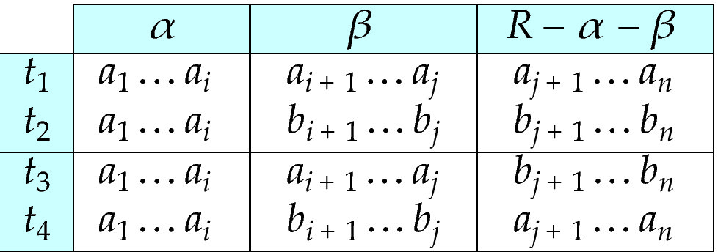
MVD -- Tabular representation
Tabular representation of α →→ β

Slide 119
MVD (Cont.)
Let R be a relation schema with a set of attributes that are partitioned into 3 nonempty subsets.
Y, Z, W
We say that Y →→ Z (Y multidetermines Z )
if and only if for all possible relations r (R )
< y₁, z₁, w₁ > ∈ r and < y₁, z₂, w₂ > ∈ r
then
< y₁, z₁, w₂ > ∈ r and < y₁, z₂, w₁ > ∈ r
Note that since the behavior of Z and W are identical it follows that
Y →→ Z if Y →→ W

Slide 120
Example
In our example:
ID →→ child_name
ID →→ phone_number
The above formal definition is supposed to formalize the notion that given a particular value of Y (ID) it has associated with it a set of values of Z (child_name) and a set of values of W (phone_number), and these two sets are in some sense independent of each other.
Note:
  If Y → Z then Y →→ Z
  Indeed we have (in above notation) Z₁ = Z₂
  The claim follows.

Slide 121
Use of Multivalued Dependencies
We use multivalued dependencies in two ways:
  1. To test relations to determine whether they are legal under a given set of functional and multivalued dependencies
  2. To specify constraints on the set of legal relations. We shall concern ourselves only with relations that satisfy a given set of functional and multivalued dependencies.
If a relation r fails to satisfy a given multivalued dependency, we can construct a relations r′ that does satisfy the multivalued dependency by adding tuples to r.

Slide 122
Theory of MVDs
From the definition of multivalued dependency, we can derive the following rule:
  If α → β, then α →→ β
That is, every functional dependency is also a multivalued dependency
The closure D⁺ of D is the set of all functional and multivalued dependencies logically implied by D.
  We can compute D⁺ from D, using the formal definitions of functional dependencies and multivalued dependencies.
  We can manage with such reasoning for very simple multivalued dependencies, which seem to be most common in practice
  For complex dependencies, it is better to reason about sets of dependencies using a system of inference rules (Appendix C).

Slide 123
Fourth Normal Form
A relation schema R is in 4NF with respect to a set D of functional and multivalued dependencies if for all multivalued dependencies in D⁺ of the form α →→ β, where α ⊆ R and β ⊆ R, at least one of the following hold:
  α →→ β is trivial (i.e., β ⊆ α or α ∪ β = R)
  α is a superkey for schema R
If a relation is in 4NF it is in BCNF

Slide 124
Restriction of Multivalued Dependencies
The restriction of D to R_{i} is the set D_{i} consisting of
  All functional dependencies in D⁺ that include only attributes of R_{i}
  All multivalued dependencies of the form
    α →→ (β ∩ R_{i})
  where α ⊆ R_{i} and α →→ β is in D⁺

Slide 125
4NF Decomposition Algorithm
result: = {R};
done := false;
compute D⁺;
Let D_{i} denote the restriction of D⁺ to R_{i}
while (not done)
if (there is a schema R_{i} in result that is not in 4NF) then
begin
let α →→ β be a nontrivial multivalued dependency that holds
on R_{i} such that α → R_{i} is not in D_{i}, and α∩β=φ;
result := (result - R_{i}) ∪ (R_{i} - β) ∪ (α, β);
end
else done:= true;
Note: each R_{i} is in 4NF, and decomposition is lossless-join

Slide 126
Example
R =(A, B, C, G, H, I)
F ={ A →→ B
B →→ HI
CG →→ H }
R is not in 4NF since A →→ B and A is not a superkey for R
Decomposition
a) R₁ = (A, B) (R₁ is in 4NF)
b) R₂ = (A, C, G, H, I) (R₂ is not in 4NF, decompose into R₃ and R₄)
c) R₃ = (C, G, H) (R₃ is in 4NF)
d) R₄ = (A, C, G, I) (R₄ is not in 4NF, decompose into R₅ and R₆)
  A →→ B and B →→ HI ➔ A →→ HI, (MVD transitivity), and
  and hence A →→ I (MVD restriction to R₄)
e) R₅ = (A, I) (R₅ is in 4NF)
f)R₆ = (A, C, G) (R₆ is in 4NF)

Slide 127
Additional issues

Slide 128
Further Normal Forms
Join dependencies generalize multivalued dependencies
  lead to project-join normal form (PJNF) (also called fifth normal form)
A class of even more general constraints, leads to a normal form called domain-key normal form.
Problem with these generalized constraints: are hard to reason with, and no set of sound and complete set of inference rules exists.
Hence rarely used

Slide 129
Overall Database Design Process
We have assumed schema R is given
R could have been generated when converting E-R diagram to a set of tables.
R could have been a single relation containing all attributes that are of interest (called universal relation).
Normalization breaks R into smaller relations.
R could have been the result of some ad hoc design of relations, which we then test/convert to normal form.

Slide 130
ER Model and Normalization
When an E-R diagram is carefully designed, identifying all entities correctly, the tables generated from the E-R diagram should not need further normalization.
However, in a real (imperfect) design, there can be functional dependencies from non-key attributes of an entity to other attributes of the entity
  Example: an employee entity with
    attributes
    department_name and building,
    functional dependency
    department_name→ building
    Good design would have made department an entity
Functional dependencies from non-key attributes of a relationship set possible, but rare --- most relationships are binary

Slide 131
Denormalization for Performance
May want to use non-normalized schema for performance
For example, displaying prereqs along with course_id, and title requires join of course with prereq
Alternative 1: Use denormalized relation containing attributes of course as well as prereq with all above attributes
  faster lookup
  extra space and extra execution time for updates
  extra coding work for programmer and possibility of error in extra code
Alternative 2: use a materialized view defined a course prereq
  Benefits and drawbacks same as above, except no extra coding work for programmer and avoids possible errors

Slide 132
Other Design Issues
Some aspects of database design are not caught by normalization
Examples of bad database design, to be avoided:
Instead of earnings (company_id, year, amount ), use
  earnings_2004, earnings_2005, earnings_2006, etc., all on the schema (company_id, earnings).
    Above are in BCNF, but make querying across years difficult and needs new table each year
  company_year (company_id, earnings_2004, earnings_2005,
  earnings_2006)
    Also in BCNF, but also makes querying across years difficult and requires new attribute each year.
    Is an example of a crosstab, where values for one attribute become column names
    Used in spreadsheets, and in data analysis tools

Slide 133
Modeling Temporal Data
Temporal data have an association time interval during which the data are valid.
A snapshot is the value of the data at a particular point in time
Several proposals to extend ER model by adding valid time to
  attributes, e.g., address of an instructor at different points in time
  entities, e.g., time duration when a student entity exists
  relationships, e.g., time during which an instructor was associated with a student as an advisor.
But no accepted standard
Adding a temporal component results in functional dependencies like
ID → street, city
not holding, because the address varies over time
A temporal functional dependency X → Y holds on schema R if the functional dependency X → Y holds on all snapshots for all legal instances r (R).

Slide 134
Modeling Temporal Data (Cont.)
In practice, database designers may add start and end time attributes to relations
  E.g., course(course_id, course_title) is replaced by
    course(course_id, course_title, start, end)
  Constraint: no two tuples can have overlapping valid times
    Hard to enforce efficiently
Foreign key references may be to current version of data, or to data at a point in time
  E.g., student transcript should refer to course information at the time the course was taken

Slide 135
End of Chapter 7

Slide 136
Proof of Correctness of 3NF Decomposition Algorithm

Slide 137
Correctness of 3NF Decomposition Algorithm
3NF decomposition algorithm is dependency preserving (since there is a relation for every FD in F_{c})
Decomposition is lossless
  A candidate key (C ) is in one of the relations R_{i} in decomposition
  Closure of candidate key under F_{c} must contain all attributes in R.
  Follow the steps of attribute closure algorithm to show there is only one tuple in the join result for each tuple in R_{i}

Slide 138
Correctness of 3NF Decomposition Algorithm (Cont.)
Claim: if a relation R_{i} is in the decomposition generated by the above algorithm, then R_{i} satisfies 3NF.
Proof:
  Let R_{i} be generated from the dependency α → β
  Let γ → B be any non-trivial functional dependency on R_{i}. (We need only consider FDs whose right-hand side is a single attribute.)
  Now, B can be in either β or α but not in both. Consider each case separately.

Slide 139
Correctness of 3NF Decomposition (Cont.)
Case 1: If B in β:
  If γ is a superkey, the 2nd condition of 3NF is satisfied
  Otherwise α must contain some attribute not in γ
  Since γ → B is in F⁺ it must be derivable from F_{c}, by using attribute closure on γ.
  Attribute closure not have used α →β. If it had been used, α must be contained in the attribute closure of γ, which is not possible, since we assumed γ is not a superkey.
  Now, using α→ (β- {B}) and γ → B, we can derive α →B
  (since γ ⊆ α β, and B ∉ γ since γ → B is non-trivial)
  Then, B is extraneous in the right-hand side of α →β; which is not possible since α →β is in F_{c}.
  Thus, if B is in β then γ must be a superkey, and the second condition of 3NF must be satisfied.

Slide 140
Correctness of 3NF Decomposition (Cont.)
Case 2: B is in α.
  Since α is a candidate key, the third alternative in the definition of 3NF is trivially satisfied.
  In fact, we cannot show that γ is a superkey.
  This shows exactly why the third alternative is present in the definition of 3NF.
Q.E.D.

Slide 141
First Normal Form
Domain is atomic if its elements are considered to be indivisible units
  Examples of non-atomic domains:
    Set of names, composite attributes
    Identification numbers like CS101 that can be broken up into parts
A relational schema R is in first normal form if the domains of all attributes of R are atomic
Non-atomic values complicate storage and encourage redundant (repeated) storage of data
  Example: Set of accounts stored with each customer, and set of owners stored with each account
  We assume all relations are in first normal form (and revisit this in Chapter 22: Object Based Databases)

Slide 142
First Normal Form (Cont.)
Atomicity is actually a property of how the elements of the domain are used.
  Example: Strings would normally be considered indivisible
  Suppose that students are given roll numbers which are strings of the form CS0012 or EE1127
  If the first two characters are extracted to find the department, the domain of roll numbers is not atomic.
  Doing so is a bad idea: leads to encoding of information in application program rather than in the database.

